Slide 1
The olive tree was planted on the rock of Acropolis. A gift of the city's patron goddess, Athena.
Notes:
The olive tree was planted on the rock of Acropolis. A gift of the city's patron goddess, Athena.

Slide 2
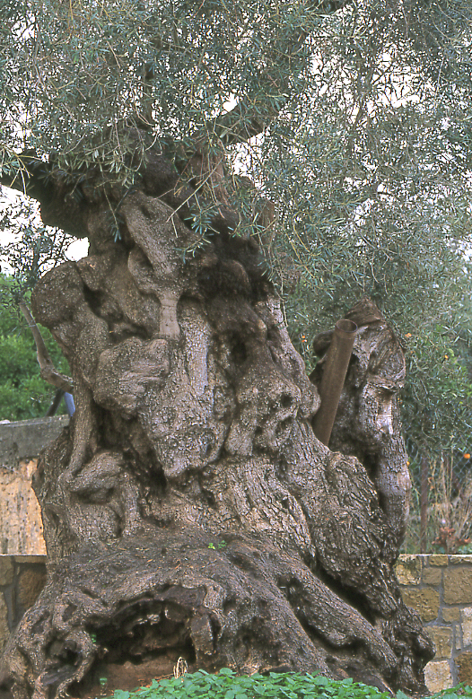
And grew old over centuries

Slide 3
Spreading its seeds from hills and valleys
Notes:
Spreading its seeds to hills and valleys

Slide 4
To the county’s shores

Slide 5
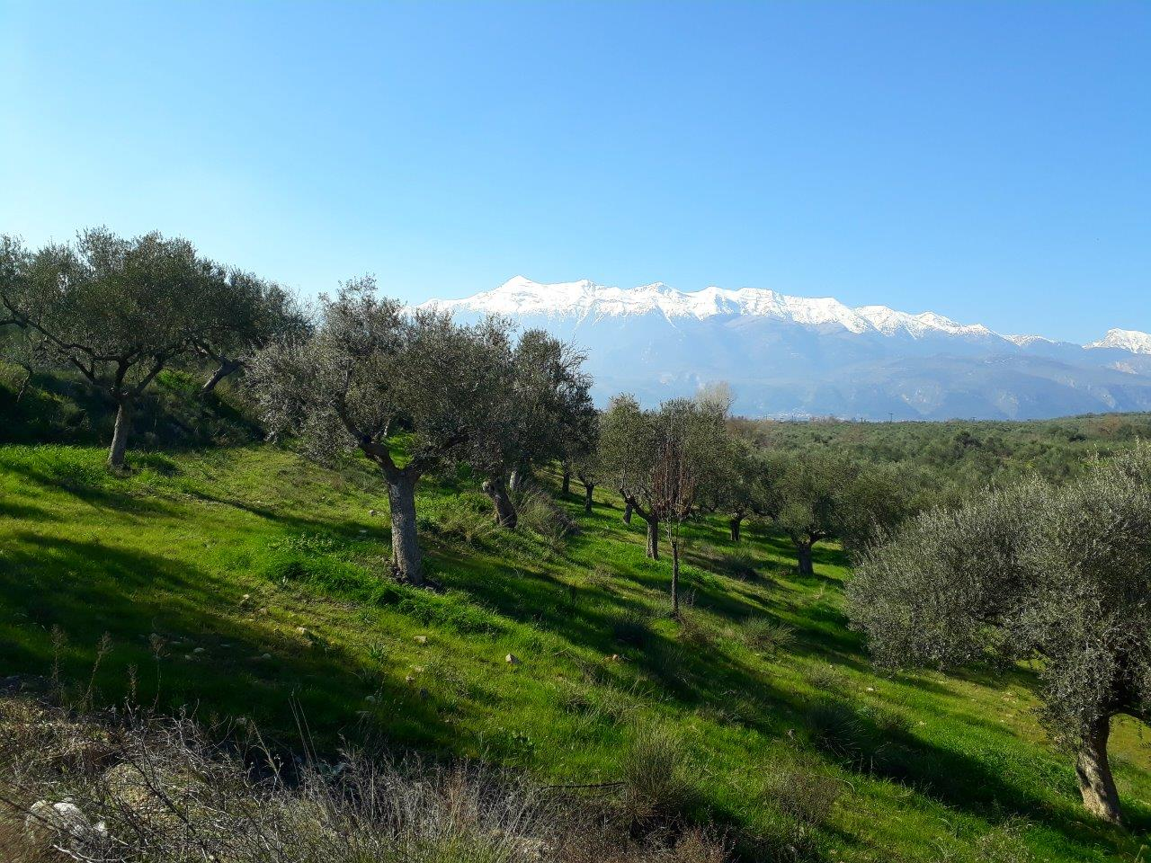
On the foothills south of Sparta
Notes:
On the foothills south of Sparta

Slide 6
And all the way to the sea
Notes:
And all the way to the sea

Slide 7
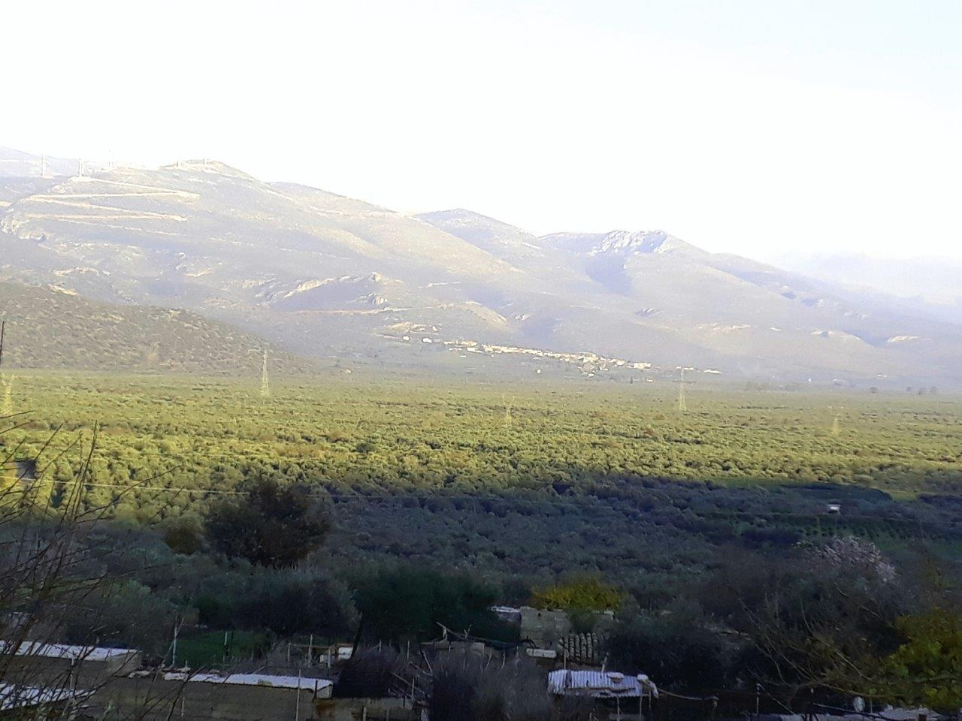
400 families grow their own under the Co-op’s expert Management
Notes:
400 families grow their own under the Co-op’s expert Management.

Slide 8
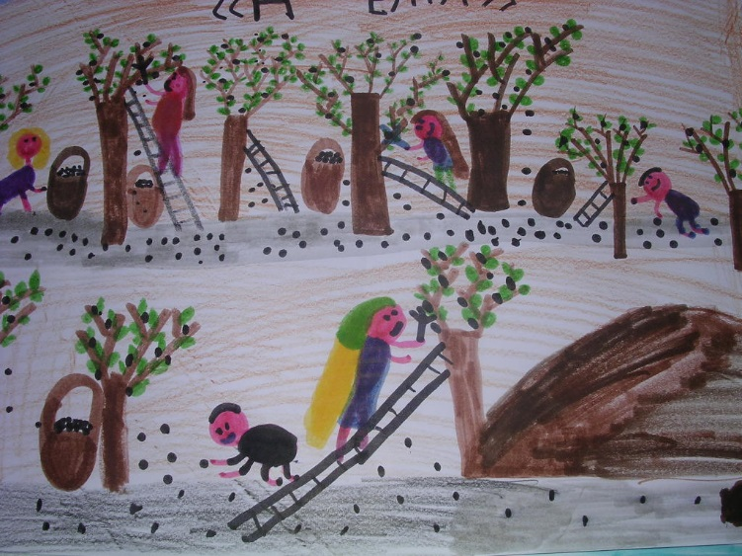
The celebrated lifeline of generations

Slide 9
Fruit fly traps replaced pesticide spraying a long time ago

Slide 10
The olives are handpicked off the trees
Notes:
The olives are harvested by hand

Slide 11
Under our watchful eye

Slide 12
And trucked away in baskets to the Mill

Slide 13
At different stages of
maturity for different
tastes

Slide 14
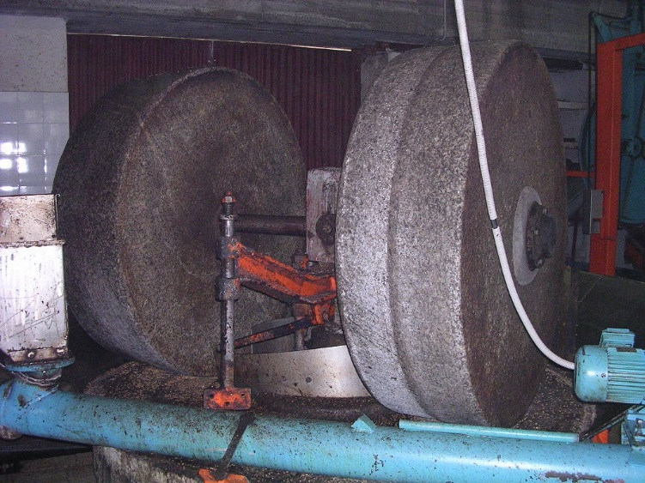
What used to be a village Press serving family needs
Notes:
What used to be a village Press serving family needs

Slide 15
Is now an industrial Mill on the Estate.

Slide 16
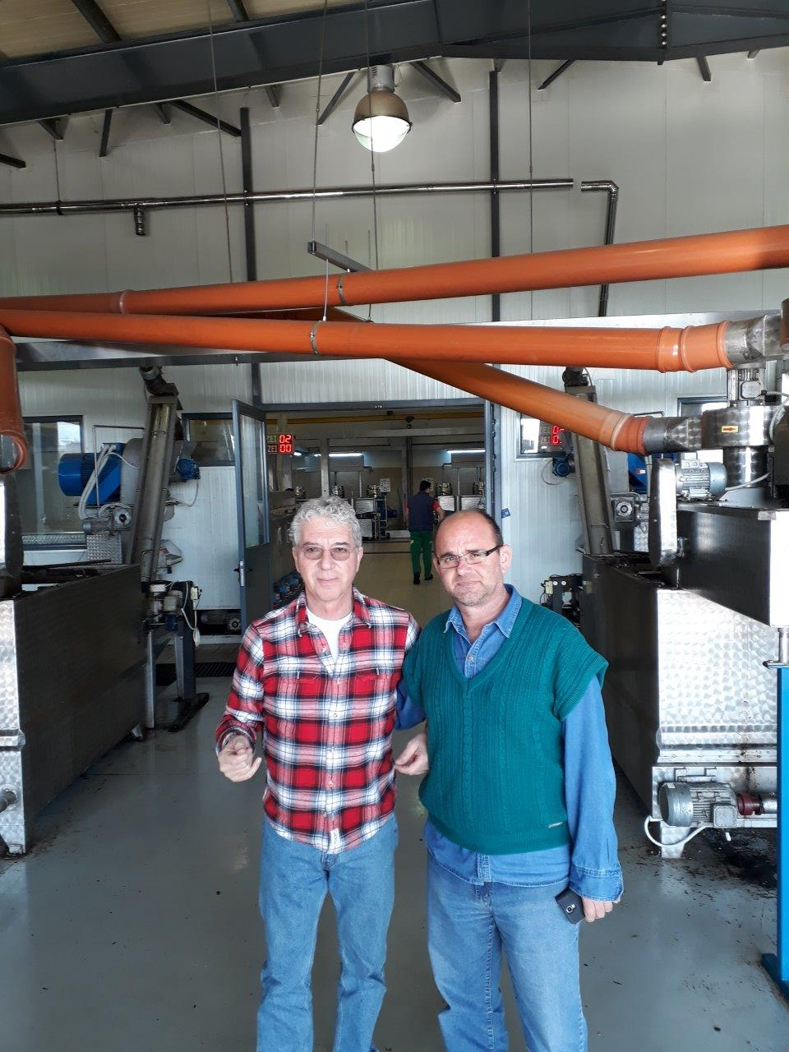
The crop is met by the Co-op Manager and me
to be milled into olive oil (video)
https://www.dropbox.com/sh/vp9evkoyzrj4ctk/AAD5cm8dHb2Bi4iUFRC0dnDGa?dl=0

Slide 17
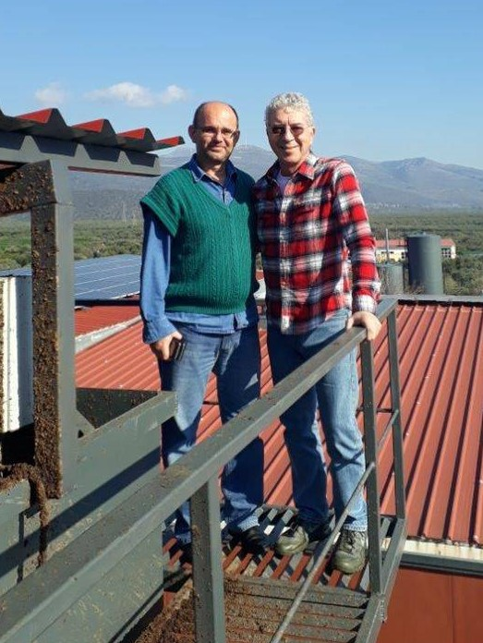
Sustainability also means an onsite Recycling Plant and Waste Treatment

Slide 18
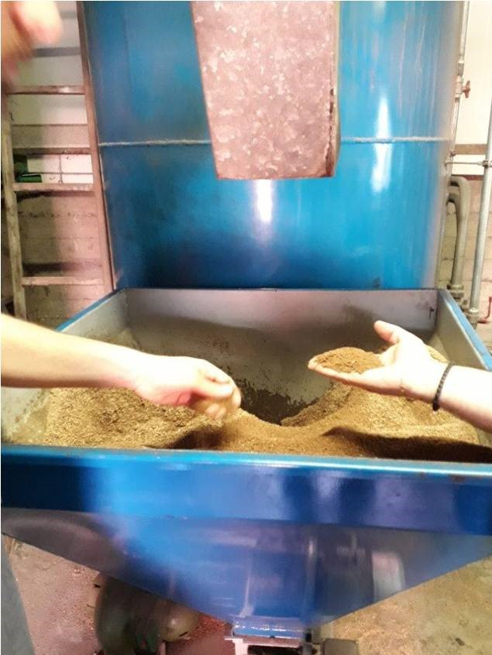
The pips of the fruit are pulverized to power the Mill.
Pruned branches and fallen leaves are used as fertilizer.
Notes:
The pips of the fruit are pulverized to power the Mill; pruned branches and fallen leaves are used as fertilizer

Slide 19
Tucked 2000 feet above the Mediterranean lies our Cretan PDO, our second source of Extra Virgin

Slide 20
Pictured here with the Cretan Co-op’s President in front of onsite storage tanks

Slide 21
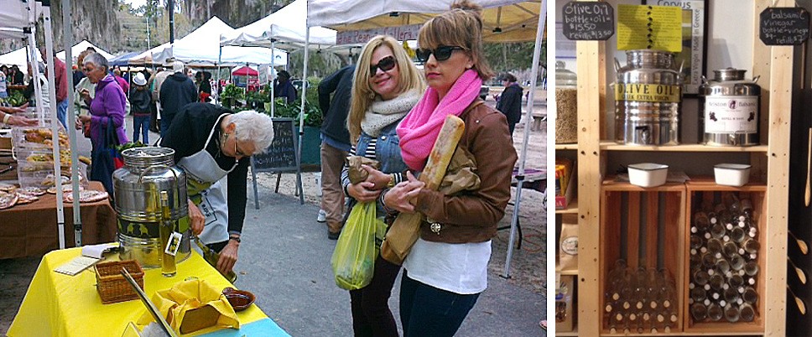
The annual harvest is tested at the Beaufort S.C. Farmers Market and various gourmet
Groceries in the Carolinas under our Corvus brand, poured out of fustis.

Slide 22
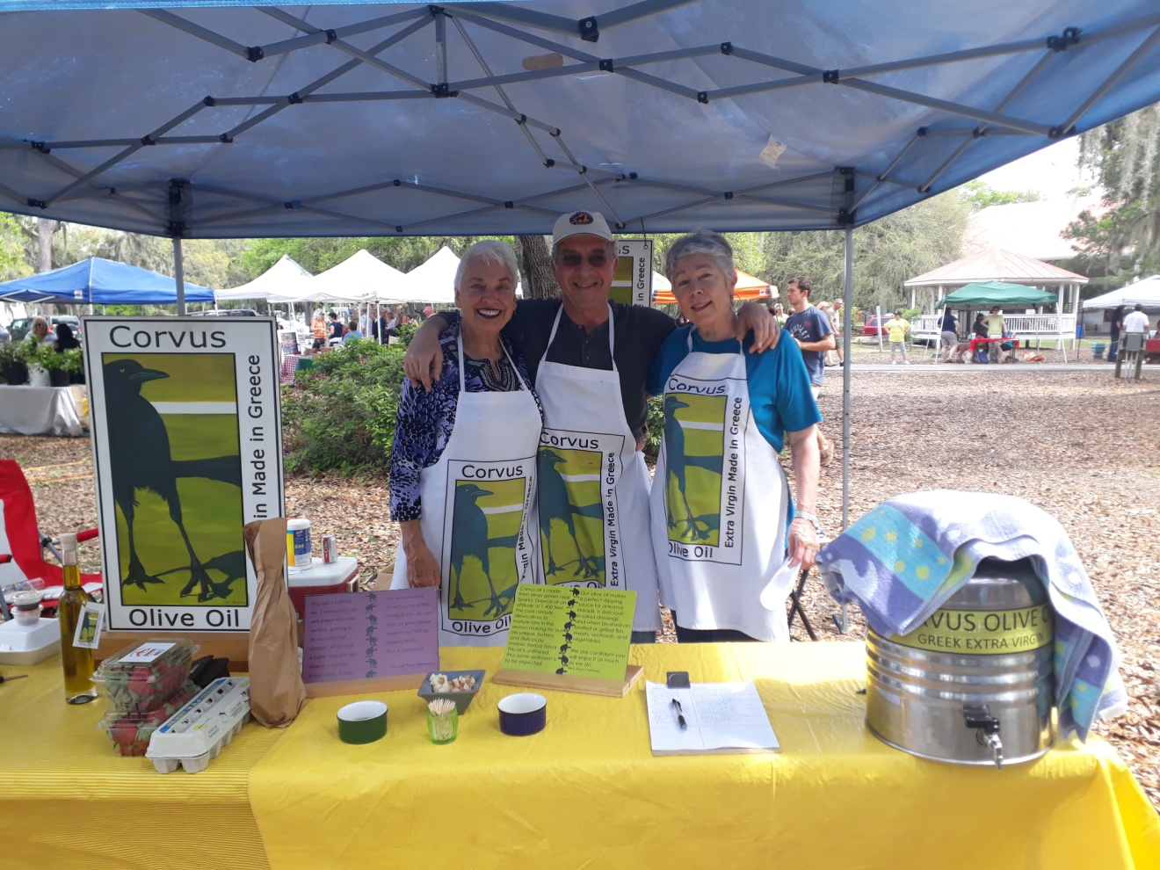
The team is delighted with two out of three customers refilling their bottles every week.

Slide 23
We started supplying universities with their annual EVOO demand.

Slide 24
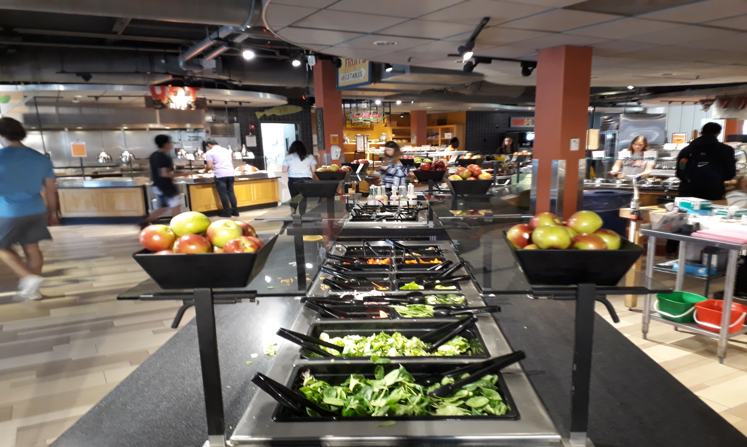
College students learn to appreciate the value of Olive Oil in their meal plans.

Slide 25
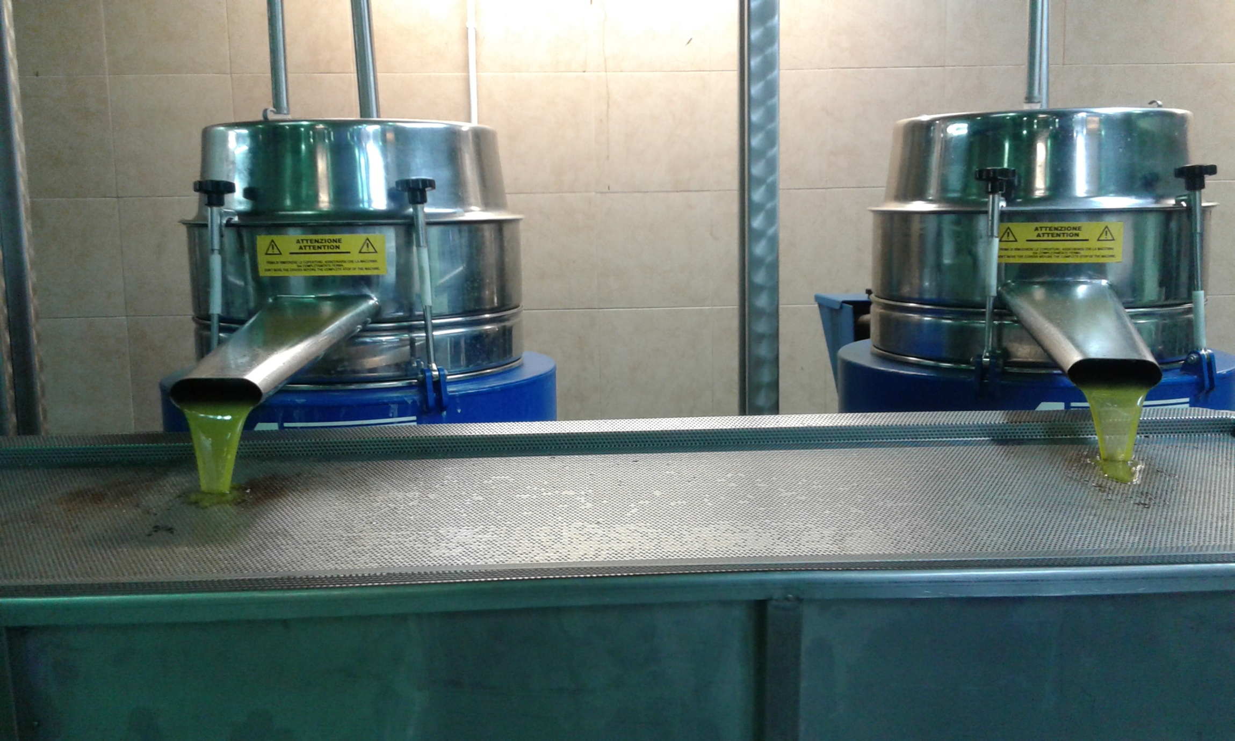
95% of Olive Oil consumed in the USA is imported. Where is yours coming from.?

Slide 26
OLIVE OIL SELECTIONS Product Information
Brand Name | Moleon, Corvus
Products | Extra Virgin Olive Oil, Unfiltered, Early Harvest & Premium
Origin | Molai, Peloponese & Viane, Crete
Varietal | Koroneiki
Cultivation | Ecological, Sustainable, Traceable
Pressed/Stored | At the Co-op Estate
Extra Virgin | Unblended, Unfiltered
Acidity | 0,28% (15 year average)
Organoleptic | Fruity (5), Pungent (3,5), Bitter (4); No Faults
Other Attributes | High polyphenols; longer shelf life (2+ years)
Annual Production | 2,000 + metric tons
Packaging | 3L and 5L cans, plus bottles or tins to order; all in cases
Shipping | In pallet or container; door-to-door
Price Point € | Auction price at the Co-op + processing and shipping
Last Update | January 2020

